Slide 1

AI Get Conversational
The Art of Possible with Azure AI

Slide 2
The Art of Possible with Azure AI
AI and its applications in Digital Enterprise
Successful Customer case studies
Azure AI ecosystem
Ready-to-use AI services
Conversational AI
Knowledge Mining

Slide 3






STEFANO TEMPESTA
/in/stefanotempesta
@stefanotempesta

Slide 4

AI and its applications in Digital Enterprise

Slide 5
What is AI?
Interpret meaning from data
Interact with people
Learn from data
Identify patterns
Predict behaviours
AI is technology that can
perceive, learn, and reason to enhance the capabilities of people and their organizations.

Slide 6
Why now?
Computing power of the cloud
Massive amounts of data
Advanced algorithms
76 percent of retail companies say they are targeting higher sales growth with machine learning.
H. James Wilson, Narendra Mulani, and Allan Alter
“Sales Gets a Machine-Learning Makeover”
MIT Sloan Management Review, May 2016

Slide 7

What does this mean for your business?
Engage customers
By 2025, 95 percent of customer
interactions will take place via bots.
Microsoft, “Powering the Future of the Customer Experience”, Nov 2017.

Slide 8

What does this mean for your business?
Empower employees
Rather than thinking in terms of human vs. machine, we want to focus on how human gifts such as creativity, empathy, emotion, physicality, and insight can be mixed with powerful AI computation […] to help move society forward.
Satya Nadella, CEO Microsoft, Hit Refresh

Slide 9

What does this mean for your business?
Engage customers
According to 69% of the use cases in a McKinsey Global Institute study, AI improved
performance beyond what existing
analytic techniques were able to deliver.
Louis Columbus, “Sizing the Market of Artificial Intelligence”, Forbes, April 2018.

Slide 10

What does this mean for your business?
Transform products
84% of enterprises believe investing in AI will lead to greater Competitive advantages.
Statista, “Business Organizations’ Reasons for Adopting Artificial Intelligence (AI) Worldwide”, 2017

Slide 11

Successful Customer case studies

Slide 12
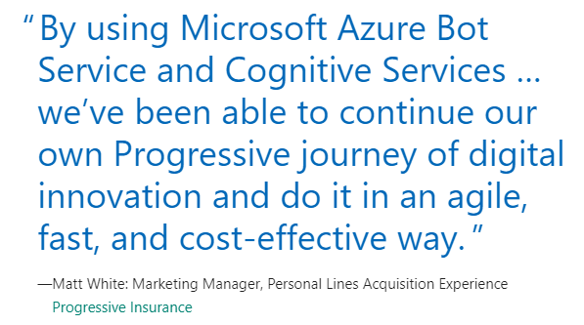
Progressive
Flo chatbot
Azure Bot Service and Cognitive Services
Language Understanding and QnA Maker

Slide 13
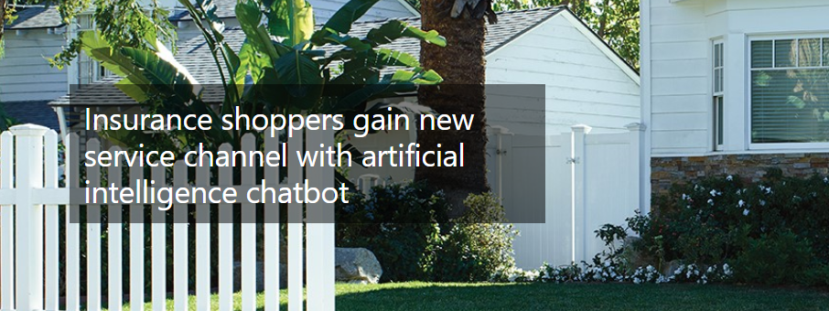
Progressive
https://customers.microsoft.com/en-us/story/progressive-insurance-cognitive-services

Slide 14
Honeywell
IoT + AI connected products
Azure IoT Hub
Millions of events per second
“Our many years of strong collaboration with Microsoft
is really key.”
Scott Harkins, vice president for Honeywell Connected Home

Slide 15

Honeywell
https://news.microsoft.com/transform/honeywells-connected-home-portfolio-powered-by-azure-helps-save-money-and-provides-peace-of-mind/

Slide 16
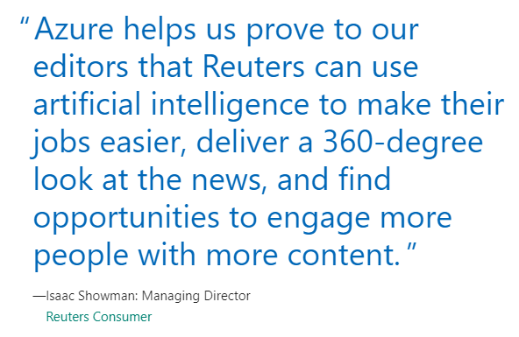
Reuters
Video recommendation engine
Azure Machine Learning
15-minute process update

Slide 17

Reuters
https://customers.microsoft.com/en-us/story/reuters-media-azuremachinelearning

Slide 18

Azure AI ecosystem

Slide 19
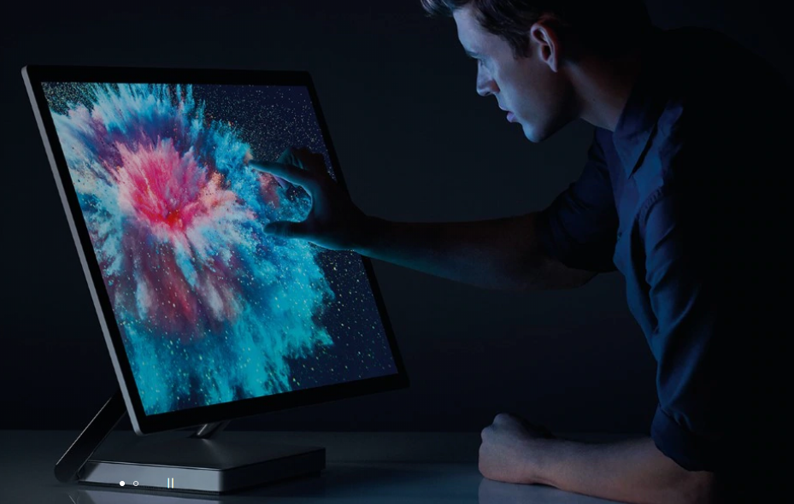
Azure AI ecosystem
Microsoft principles of AI
Doing AI responsibly
Ready-to-use AI Services
Conversational AI
Knowledge Mining with AI

Slide 20
Microsoft AI principles
Fairness
Reliability & Safety
Privacy & Security
Inclusiveness
Transparency
Accountability
Designing AI to be trustworthy requires creating solutions that reflect ethical principles that are deeply rooted in important and timeless values.
https://www.microsoft.com/en-us/ai/our-approach-to-ai

Slide 21
Guidelines for responsible bots
Purpose
Transparency
Culture awareness
Reliability
Fairness
Respect for privacy
Data protection
Accessibility
Hand-off to human
Conversational AI bots must be designed in a way that they earn the trust of others. Learn the principles to building bots that create confidence in your company and services.
https://www.microsoft.com/research/publication/responsible-bots/

Slide 22
AI for Good
Earth
Accessibility
Humanitarian Action
Cultural Heritage
Applied AI uses technology to empower solutions to humanitarian issues and create a more sustainable and accessible world.
https://www.microsoft.com/en-us/ai/ai-for-good

Slide 23

Ready-to-use AI services

Slide 24
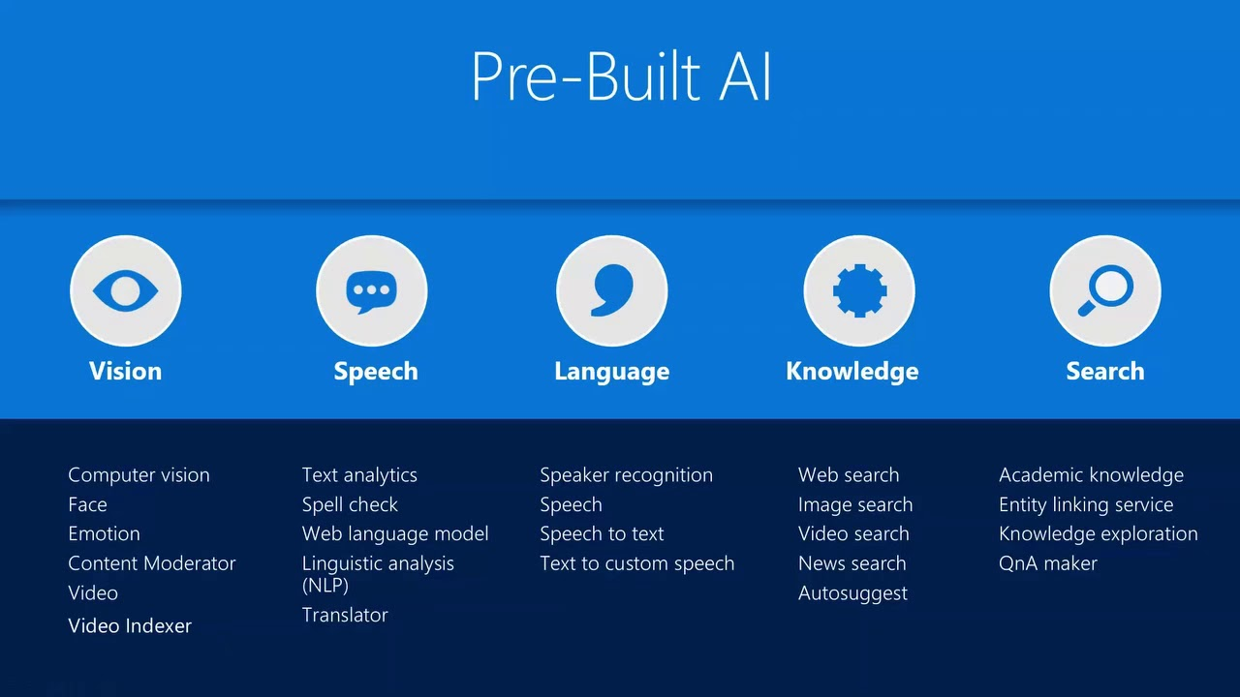

Slide 25
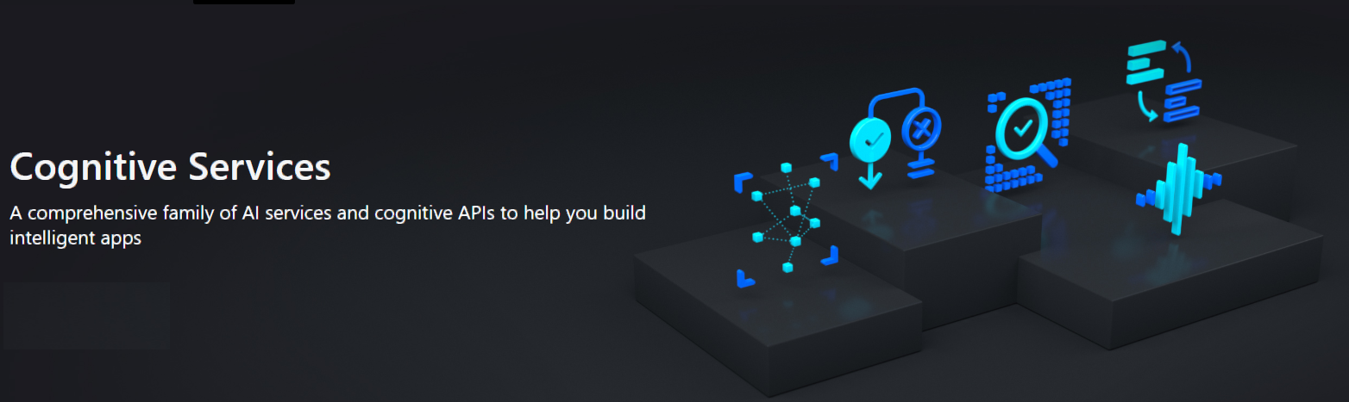
Cognitive Services
https://azure.microsoft.com/services/cognitive-services/

Slide 26
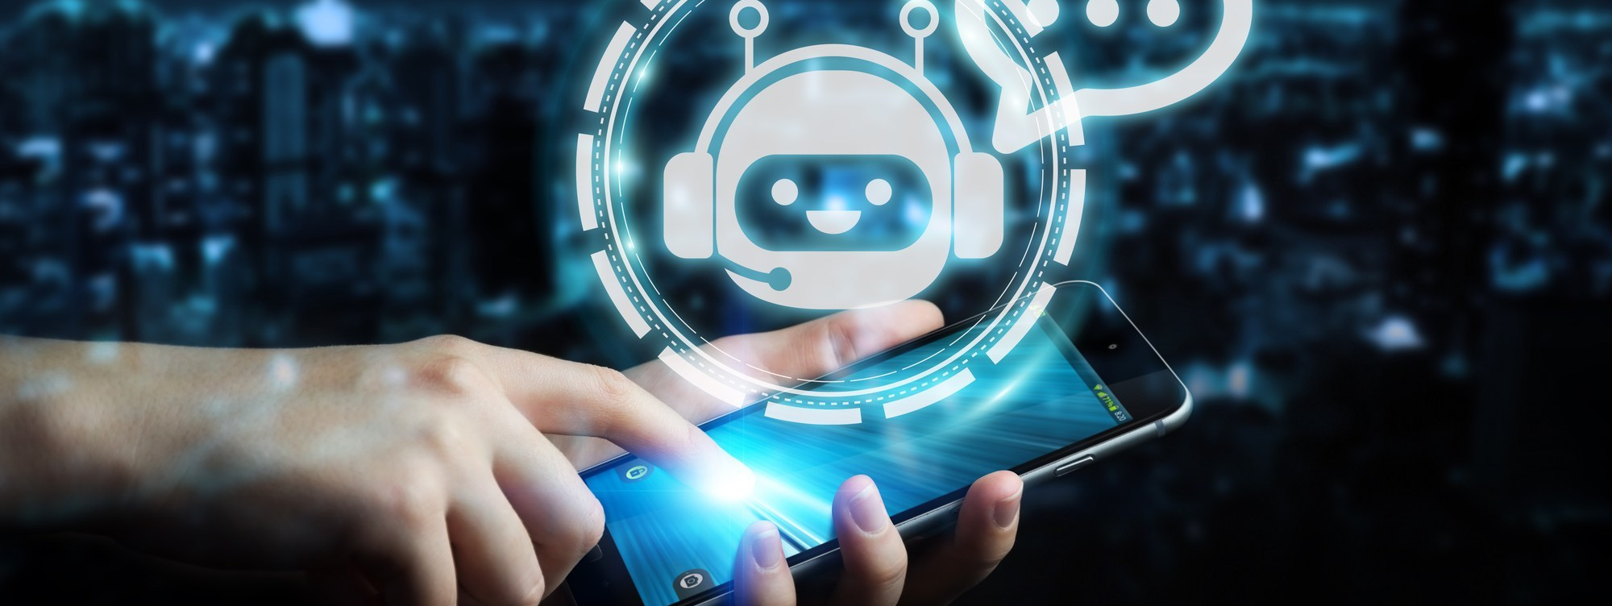
Conversational AI

Slide 27
Conversational AI
Azure Bot Service, QnA Maker and LUIS
Azure Portal → Web App Bot (managed chatbot)
Microsoft Teams

Slide 28
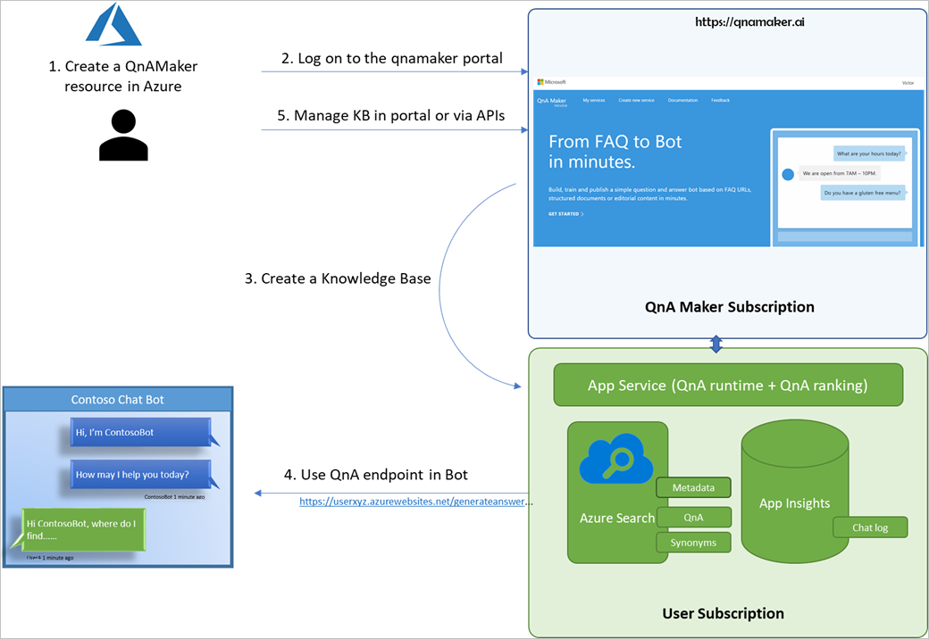
Azure Bot Service

Slide 29
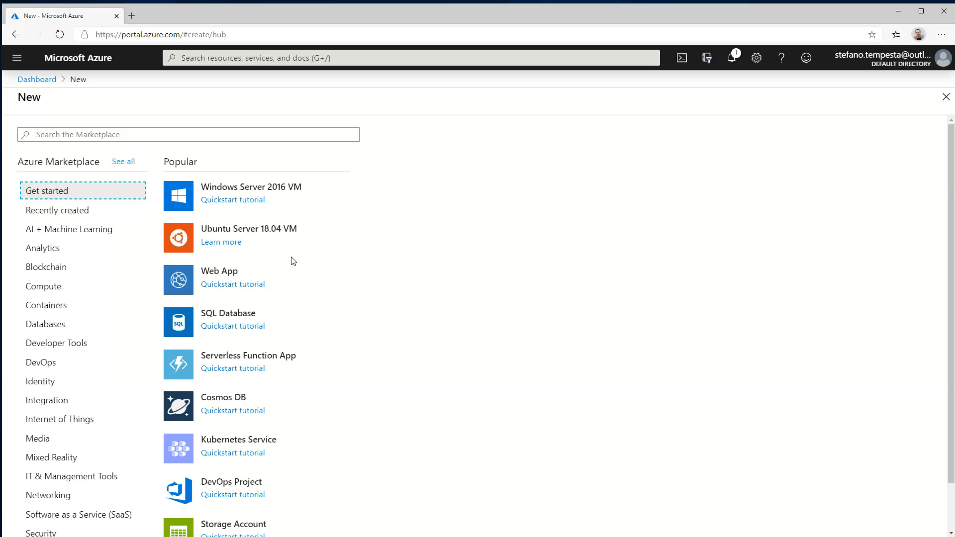

Slide 30
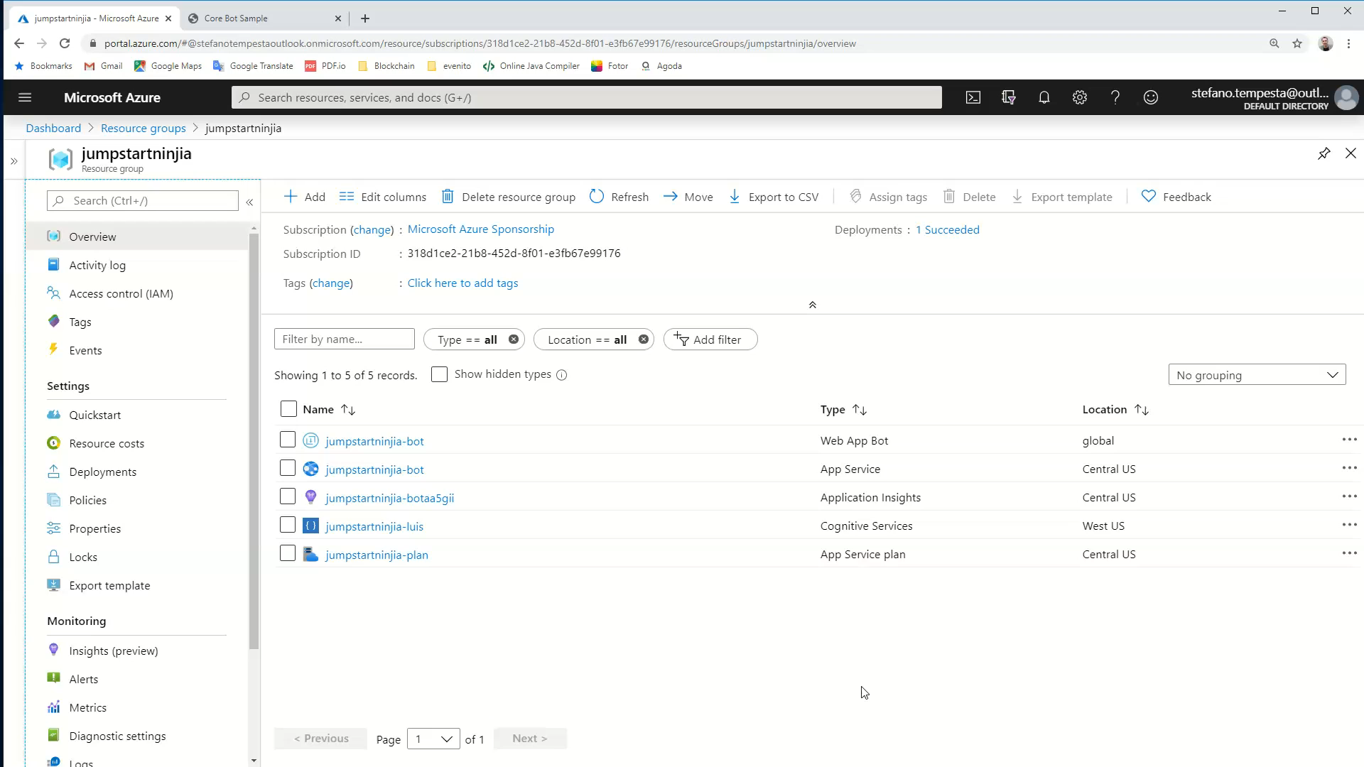

Slide 31

Knowledge Mining

Slide 32
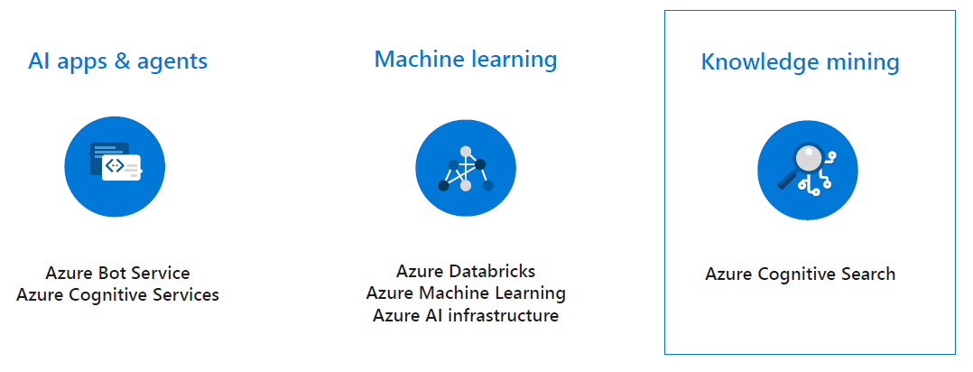
Knowledge Mining
Key Technology Components Overview
-Azure Search, Extraction Data from Documents & Photos, Indexing Data and Retrieving with Speech and Scale
Business Value Driven with a Case Study

Slide 33
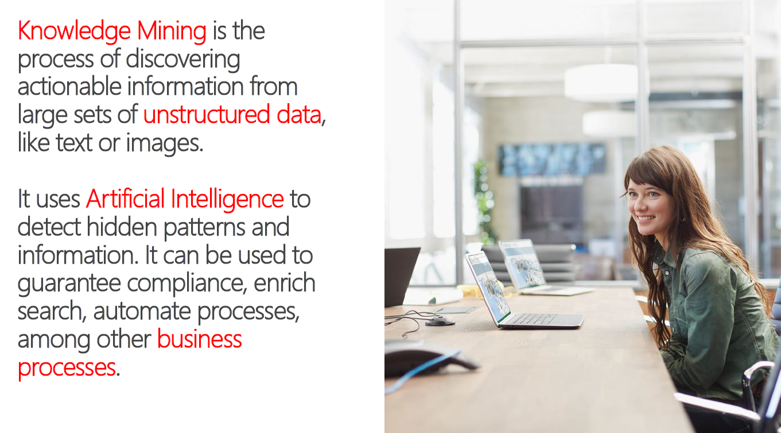

Slide 34
Azure Search
AI Powered cloud search service for web and mobile app development
Enterprise Search as a Service Azure PaaS product
Enrich and extract insights through cognitive skills (Cognitive Search)
Easily scale up and down
Natural Language Processing for web search grade experience
Connect search results to business goals with great control over search ranking
99.9% SLA, GDPR, Standard Azure OST (Online Service Terms)

Slide 35
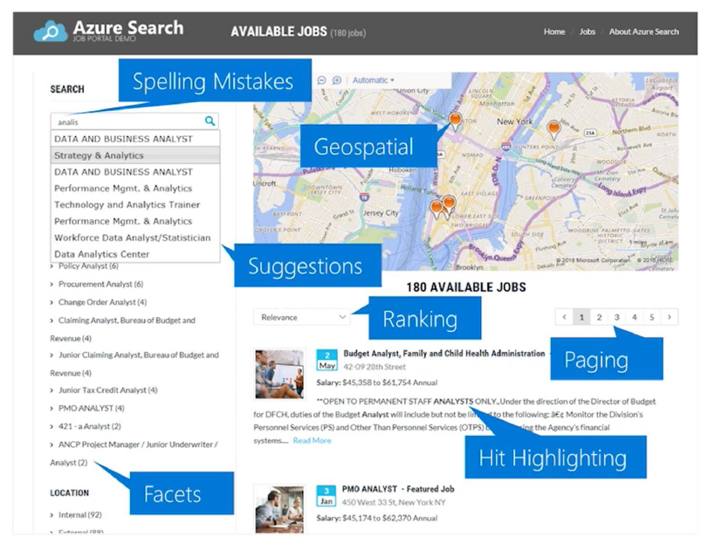

Slide 36
Cognitive Search
Azure Search feature
Uses AI to create searchable metadata, transforming unstructured data into information.
Data enrichment and not Data integration → Original data is not moved, changed or copied.

Slide 37
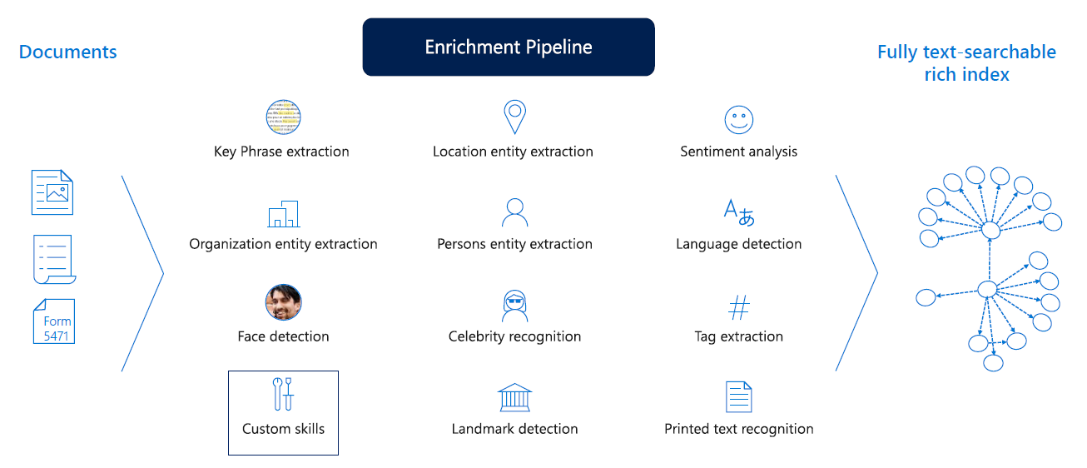

Slide 38
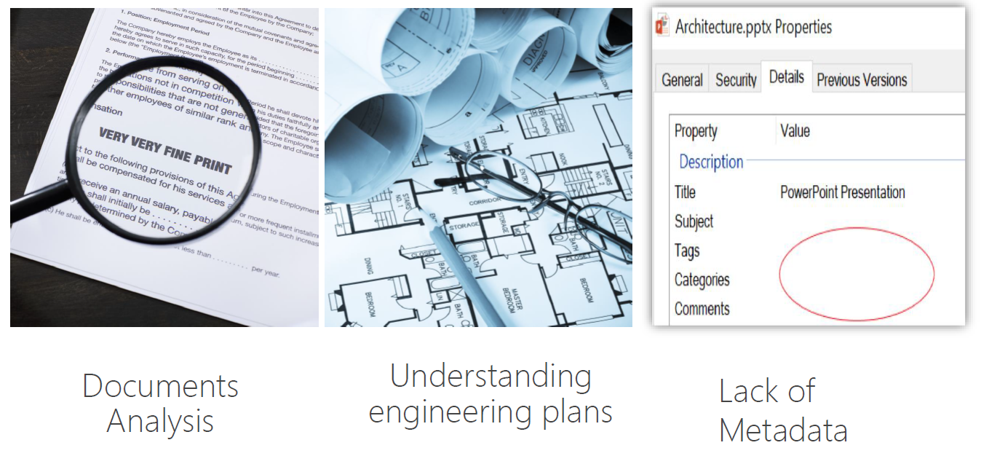
Use cases

Slide 39
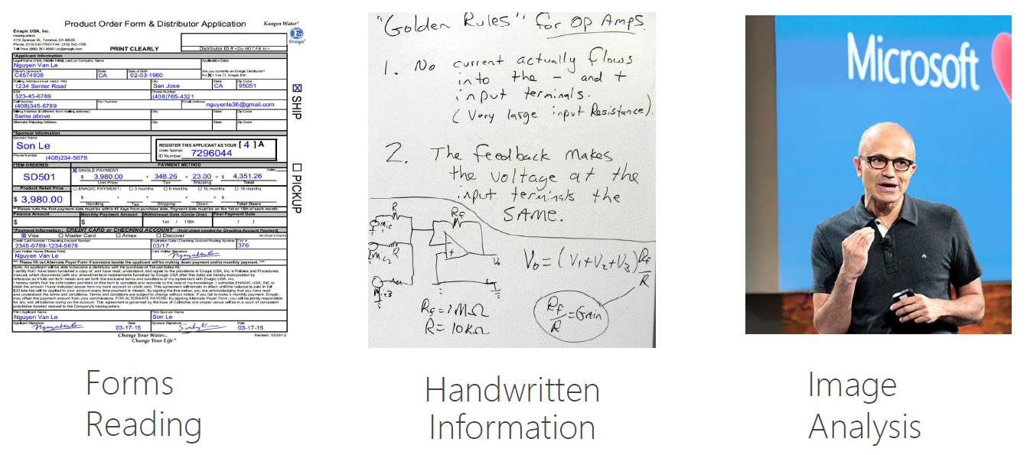
Use cases

Slide 40
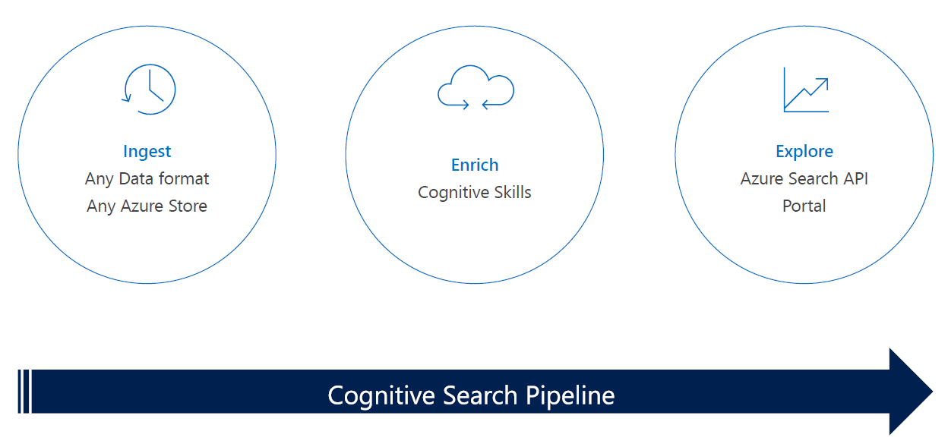

Slide 41
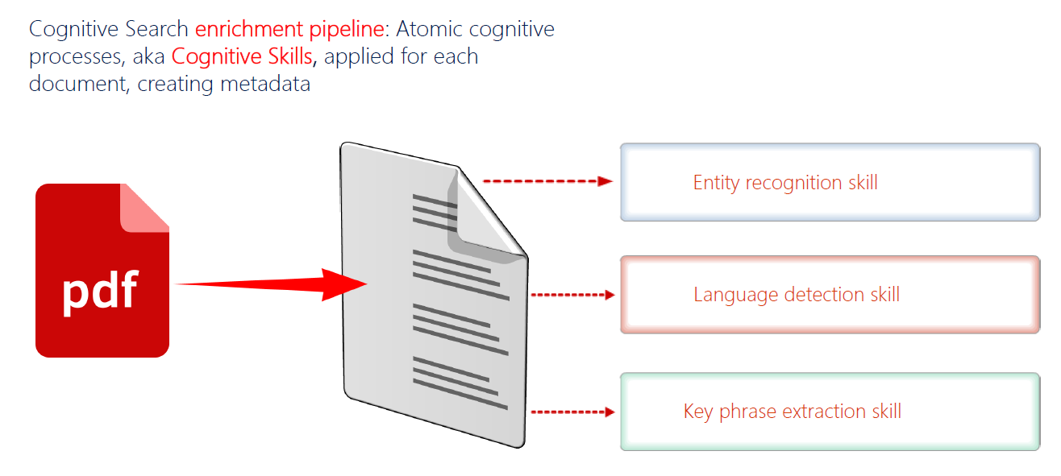

Slide 42
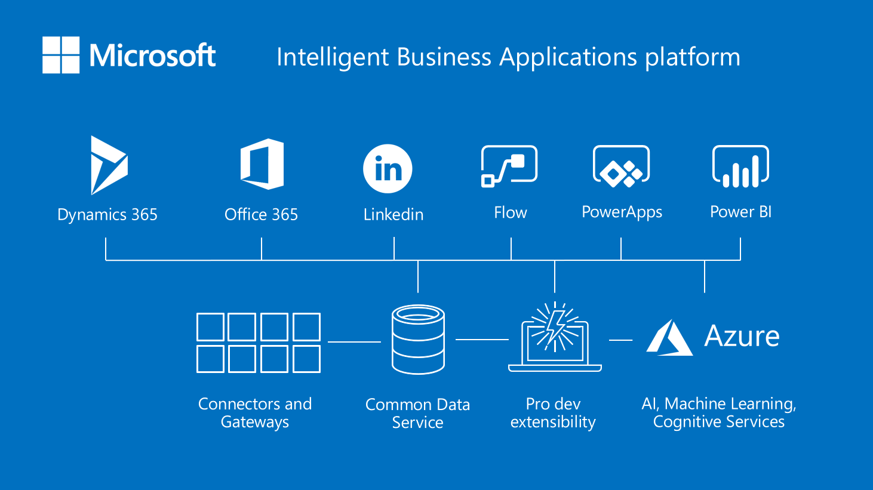

Slide 43
Get started
AI School https://aischool.microsoft.com/
AI Lab https://www.microsoft.com/ai/ai-lab
AI Demos https://aidemos.microsoft.com/
Notes:
AI School
Whether you’re brand new to AI or looking to enhance your skills, AI School offers learning opportunities in machine learning, conversational AI, AI services, and intelligent edge AI.
AI Lab
Ready to create an AI project? Check out our projects to learn and code real AI, play around with experimental apps, and share your work with others.
AI Demos
Get hands on and experiment with our interactive demos that bring Microsoft AI technology to life. Build these into your apps to create new, personalized, and intuitive experiences.

Slide 44
The promise of AI
Global GDP will increases by 14% by 2030 (PwC)
Impact on growth (90%), productivity (86%), and job creation (69%)
Increase their AI investment by more than 50%
Organizations need long-term strategy and a technology partner

Slide 45
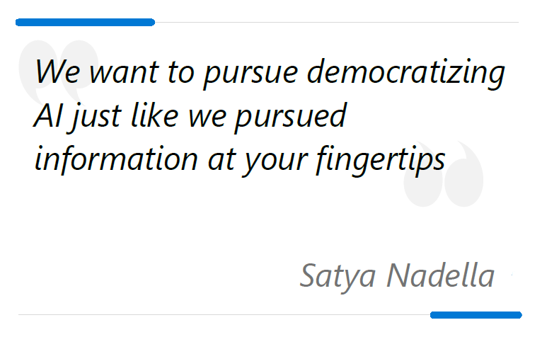

Slide 46
Redefining business through AI
Every application, every business process, and every employee
75% of commercial enterprise apps will use AI by 2021 (IDC)
Comprehensive AI platform
Trusted AI services
Cognitive Services
Machine Learning
Conversational AI
Knowledge Mining

Slide 47

AI across industries
Financial services → Next best action, risk analysis, fraud detection
Manufacturing → Predictive maintenance, performance improvements
Retail → Sales personalization, dynamic pricing and planning

Slide 48

AI across industries
Public sector → smart cities, citizen services
Healthcare → Personalized medicine, bot service, inner eye
Education → Accessibility, new ways of learning

Slide 49
STEFANO TEMPESTA
/in/stefanotempesta
@stefanotempesta

